Slide 1
Hierarchical clustering

Slide 2
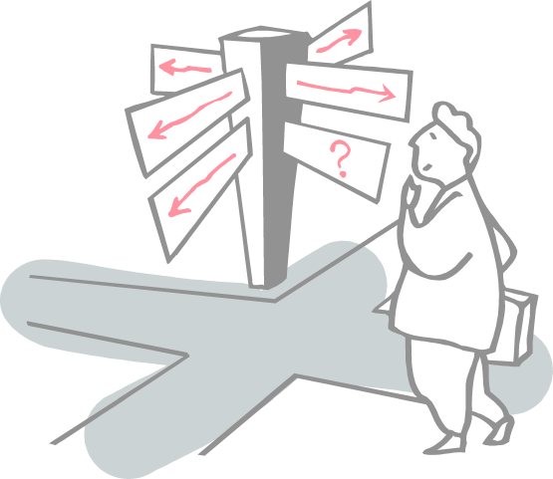
Roadmap
What is Clustering??
Clustering Vs Classification/Regression
Hierarchical clustering Technique
Agglomerative Hierarchical clustering
Dendrogram

Slide 3
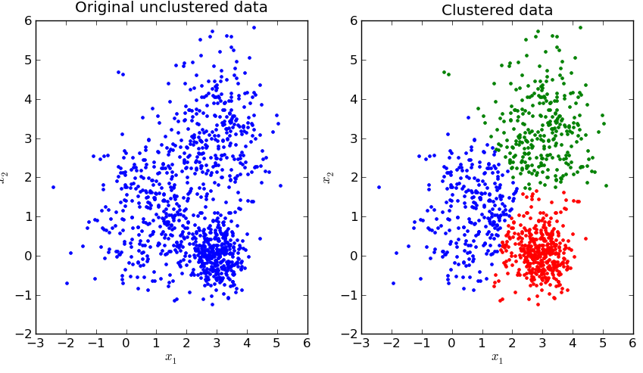
What is Clustering??
Clustering is basically a technique that groups similar data points such that the points in the same group are more similar to each other than the points in the other groups.
The group of similar data points is called a Cluster

Slide 4
Clustering Vs. Classification/Regression
In classification and regression models,
Given a data set(D) which contains data points(Xi) and class labels(Yi). Where, Yi’s belong to {0,1} or {0,1,2,…,n) for Classification models and Yi’s belong to real values for regression models.
When comes to clustering,
a data set that contains only data points(Xi).
not provided with the class labels(Yi).

Slide 5
Hierarchical clustering Technique
This clustering technique is divided into two types:
Agglomerative (AGNES -AGglomerative NESting)
Divisive (DIANA -DIvise ANAlysis)

Slide 6
Agglomerative Hierarchical clustering
Initially each data point is considered as an individual cluster.
At each iteration, the similar clusters merge with other clusters until one cluster or K clusters are formed.
Basic algorithm of Agglomerative is straight forward.
Compute the proximity matrix
Let each data point be a cluster
Repeat: Merge the two closest clusters and update the proximity matrix
Until only a single cluster remains

Slide 7
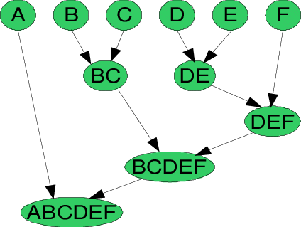
Agglomerative Hierarchical clustering
Key operation is the computation of the proximity of two clusters
Lets us have six data points {A,B,C,D,E,F}.
Step- 1: In the initial step, the proximity of individual points and consider all the six data points as individual clusters as shown in the image below.

Slide 8
Agglomerative Hierarchical clustering
Step- 2: In step two, similar clusters are merged together and formed as a single cluster.
Let’s consider B,C, and D,E are similar clusters that are merged in step two.
Now, left with four clusters which are A, BC, DE, F.

Slide 9
Agglomerative Hierarchical clustering
Step- 3:Calculate the proximity of new clusters and merge the similar clusters to form new clusters A, BC, DEF.
Step- 4:
Calculate the proximity of the new clusters.
The clusters DEF and BC are similar and merged together to form a new cluster. We’re now left with two clusters A, BCDEF.

Slide 10
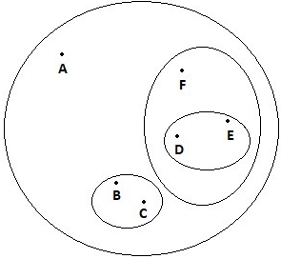
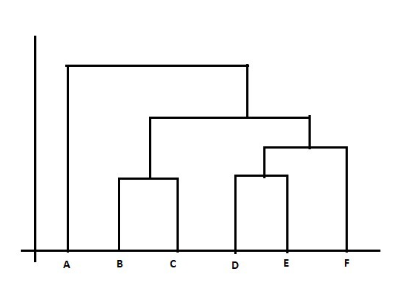
Agglomerative Hierarchical clustering
Step- 5: Finally, all the clusters are merged together and form a single cluster.
The Hierarchical clustering Technique can be visualized using a Dendrogram.
A Dendrogram is a tree-like diagram that records the sequences of merges or splits.

Slide 11
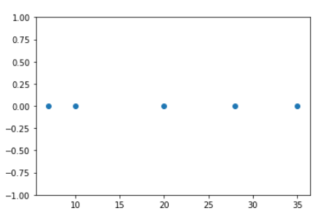
Agglomerative Hierarchical clustering Example
For the one dimensional data set {7,10,20,28,35}, perform hierarchical clustering and plot the dendogram to visualize it

Slide 12
Agglomerative Hierarchical clustering Example
For the one dimensional data set {7,10,20,28,35}, perform hierarchical clustering and plot the dendogram to visualize it
Observing the plot above, we can intuitively conclude that:
The first two points (7 and 10) are close to each other and should be in the same cluster
Also, the last two points (28 and 35) are close to each other and should be in the same cluster
Cluster of the center point (20) is not easy to conclude

Slide 13
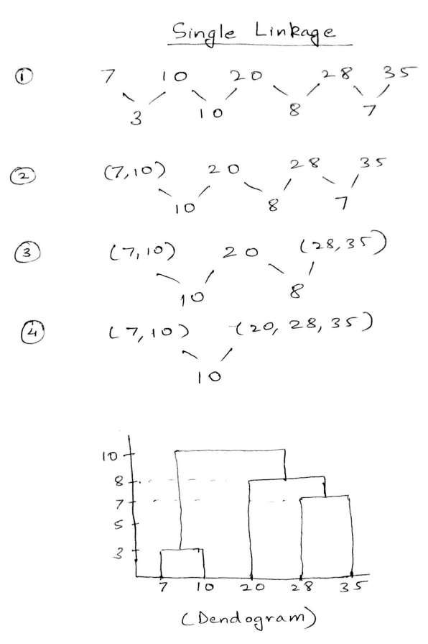
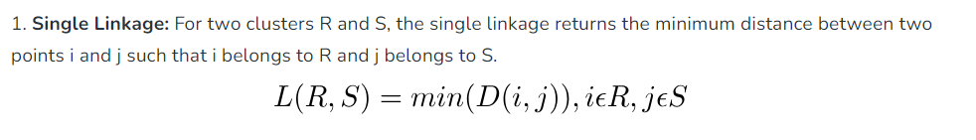
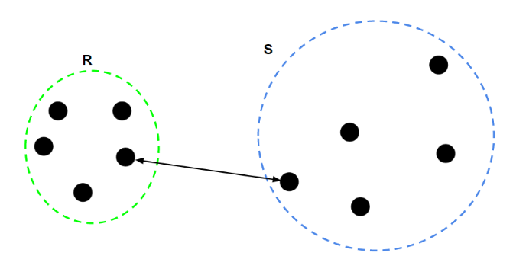
Agglomerative Hierarchical clustering Example
Single Linkage
Cluster 1 : (7,10)
Cluster 2 : (20,28,35)

Slide 14
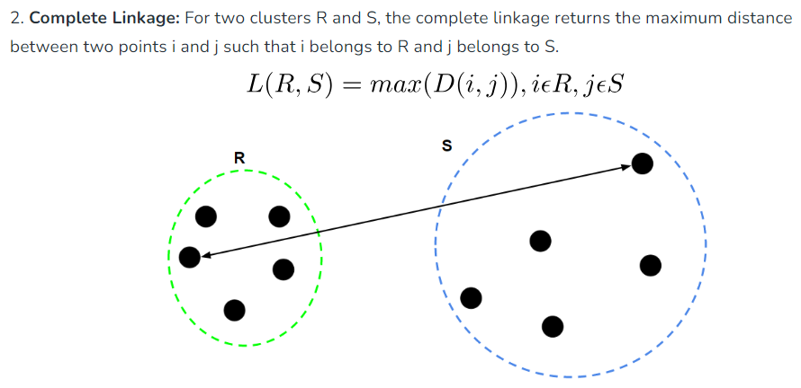
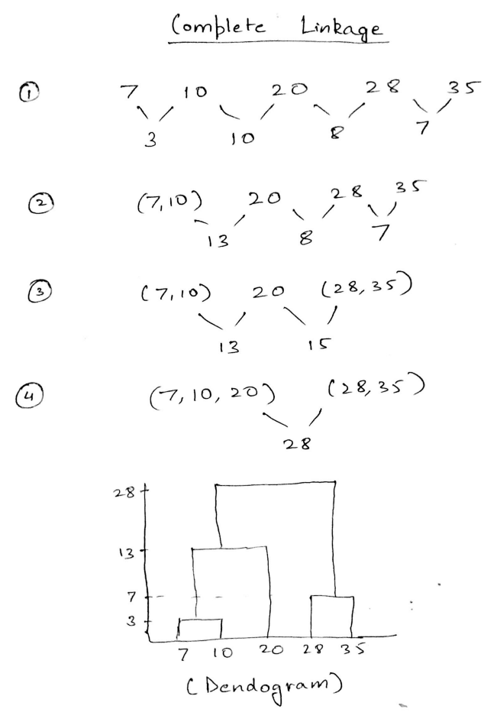
Agglomerative Hierarchical clustering Example
Complete Linkage
Cluster 1 : (7,10,20)
Cluster 2 : (28,35)

Slide 15
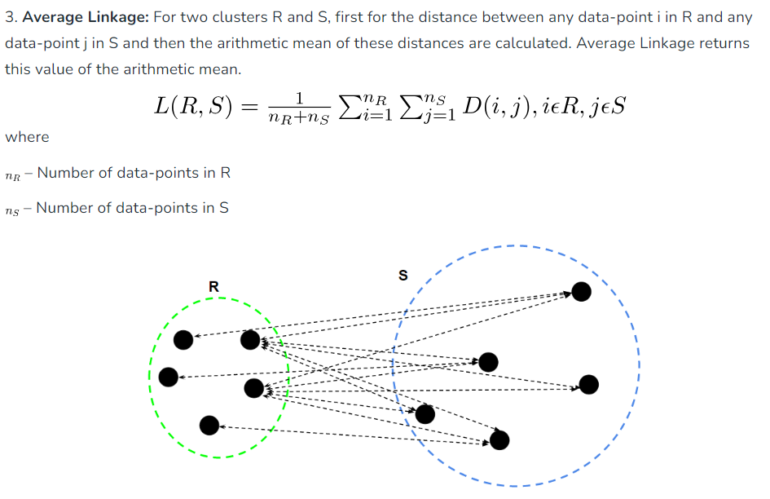
Agglomerative Hierarchical clustering Example

Slide 16
Divisive Hierarchical clustering Technique
Divisive Hierarchical clustering is exactly the opposite of the Agglomerative Hierarchical clustering
Consider all the data points as a single cluster and in each iteration, separate the data points from the cluster which are not similar
Each data point which is separated is considered as an individual cluster.
End with n clusters
Dividing the single clusters into n clusters, it is named as DivisiveHierarchical clustering

Slide 17
Example: single link

Slide 18
Example: single link

Slide 19
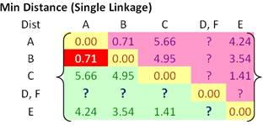
Example: single link

Slide 20
Example: single link

Slide 21
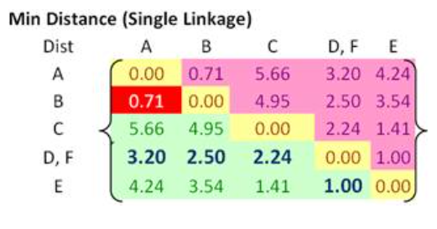
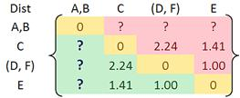
Example: single link

Slide 22
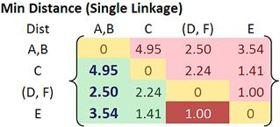
Example: single link

Slide 23
Example: single link

Slide 24
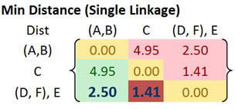
Example: single link

Slide 25
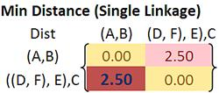
Example: single link

Slide 26
Example: single link

Slide 27
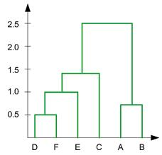
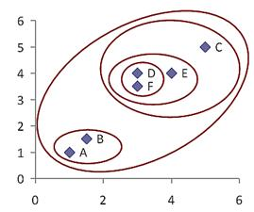
Example: single link results in dendogram

Slide 28
Exercise – 1 – Apply Single link & draw dendrogram ☺

Slide 29
Exercise – 1 – Apply Single link & draw dendrogram ☺

Slide 30
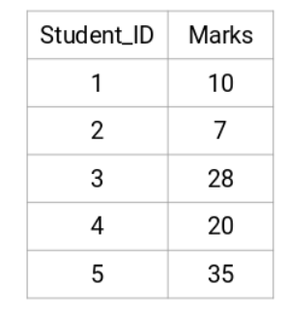
Example - 2

Slide 31
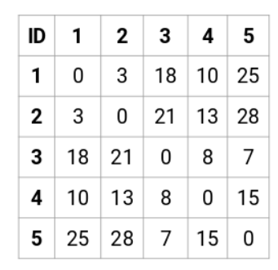

Example – 2 – Try to Solve
The diagonal elements of this matrix will always be 0 as the distance of a point with itself is always 0.

Slide 32
References
https://cse.buffalo.edu/~jing/cse601/fa12/materials/clustering_hierarchical.pdf
https://people.revoledu.com/kardi/tutorial/Clustering/Numerical%20Example.htm
http://www.yorku.ca/ptryfos/f1500.pdf

Slide 33
Thanks

